Slide 1
أكـــــاديميــــة طــــويـــق
Artificial Intelligence Ethics

Slide 2
Accountability and Ethical challenges in AI Decision-Making
By: Dr. Afshan Hashmi

Slide 3
Course Objectives:
Define accountability in AI decision-making.
Identify who is responsible for AI decisions (developers, users, organizations).
Explore mechanisms for ensuring AI accountability (audits, certifications, ethical boards).
Understand ethical challenges in AI deployment, including bias, fairness, and security.
Analyze regulatory challenges, including global vs. local AI governance.
Evaluate the role of AI in critical sectors like healthcare, justice, and finance.

Slide 4

Introduction to Accountability in AI Systems
Accountability in AI refers to the responsibility of individuals, organizations, or systems for the decisions made by artificial intelligence models.
AI accountability refers to assigning responsibility for decisions made by AI systems.
This ensures transparency, fairness, and compliance with ethical/legal standards.
As AI systems increasingly influence critical areas like healthcare, finance, and law enforcement, ensuring responsible AI decision-making becomes essential.
Example:
AI-driven loan approval system rejects applications from a particular ethnic group unfairly.
Who is responsible for the bias? The developer? The organization using the AI? The AI itself?

Slide 5
Defining Accountability in AI Systems
Accountability in AI involves:
Transparency: Understanding how AI reaches its decisions.
Fairness: Ensuring AI does not reinforce biases or unethical behaviors.
Responsibility: Assigning clear roles for monitoring AI decisions and addressing errors.
Compliance: Adhering to legal and ethical guidelines for AI governance.
Accountability
Transparency
Compliance
Responsibility
Fairness

Slide 6
Key Stakeholders & Their Responsibilities:
Stakeholder | Role in AI Decision-Making
Developers (AI Engineers, Data Scientists) | Ensure AI fairness, transparency, and unbiased training.
Organizations (Companies, Governments, Institutions) | Deploy AI responsibly and ensure compliance.
Users (Customers, Employees, General Public) | Understand AI recommendations and raise concerns when needed.
Regulators (Lawmakers, AI Ethics Boards) | Create policies and ensure AI accountability.

Slide 7
Mechanisms for Establishing Accountability
Several mechanisms help in ensuring AI accountability:
a) AI Audits
Regularly reviewing AI systems to detect biases and unintended consequences.
Identifying errors in training data, model performance, and real-world applications.
b) Certifications and Standards
AI systems can be assessed against frameworks such as:
ISO/IEC 42001 – AI management system standards.
IEEE Ethically Aligned Design – Guidelines for responsible AI.
Certification ensures AI compliance with ethical and legal standards.
c) Ethical Boards & Governance Committees
Organizations form AI ethics committees to oversee AI deployment.
These boards ensure fairness, prevent discrimination, and protect users.

Slide 8
Summarizing AI Accountability AI accountability is crucial to prevent misuse and ensure fairness. Multiple stakeholders (developers, organizations, users, regulators) play a role in accountability. AI audits, certifications, and ethical boards help monitor and enforce responsible AI use. Accountability in AI is critical to building trust and mitigating risks. Developers, organizations, and regulators must collaborate to ensure AI systems are transparent, fair, and responsible. By implementing audits, certifications, and ethical oversight, we can create AI systems that align with human values and societal expectations.

Slide 9
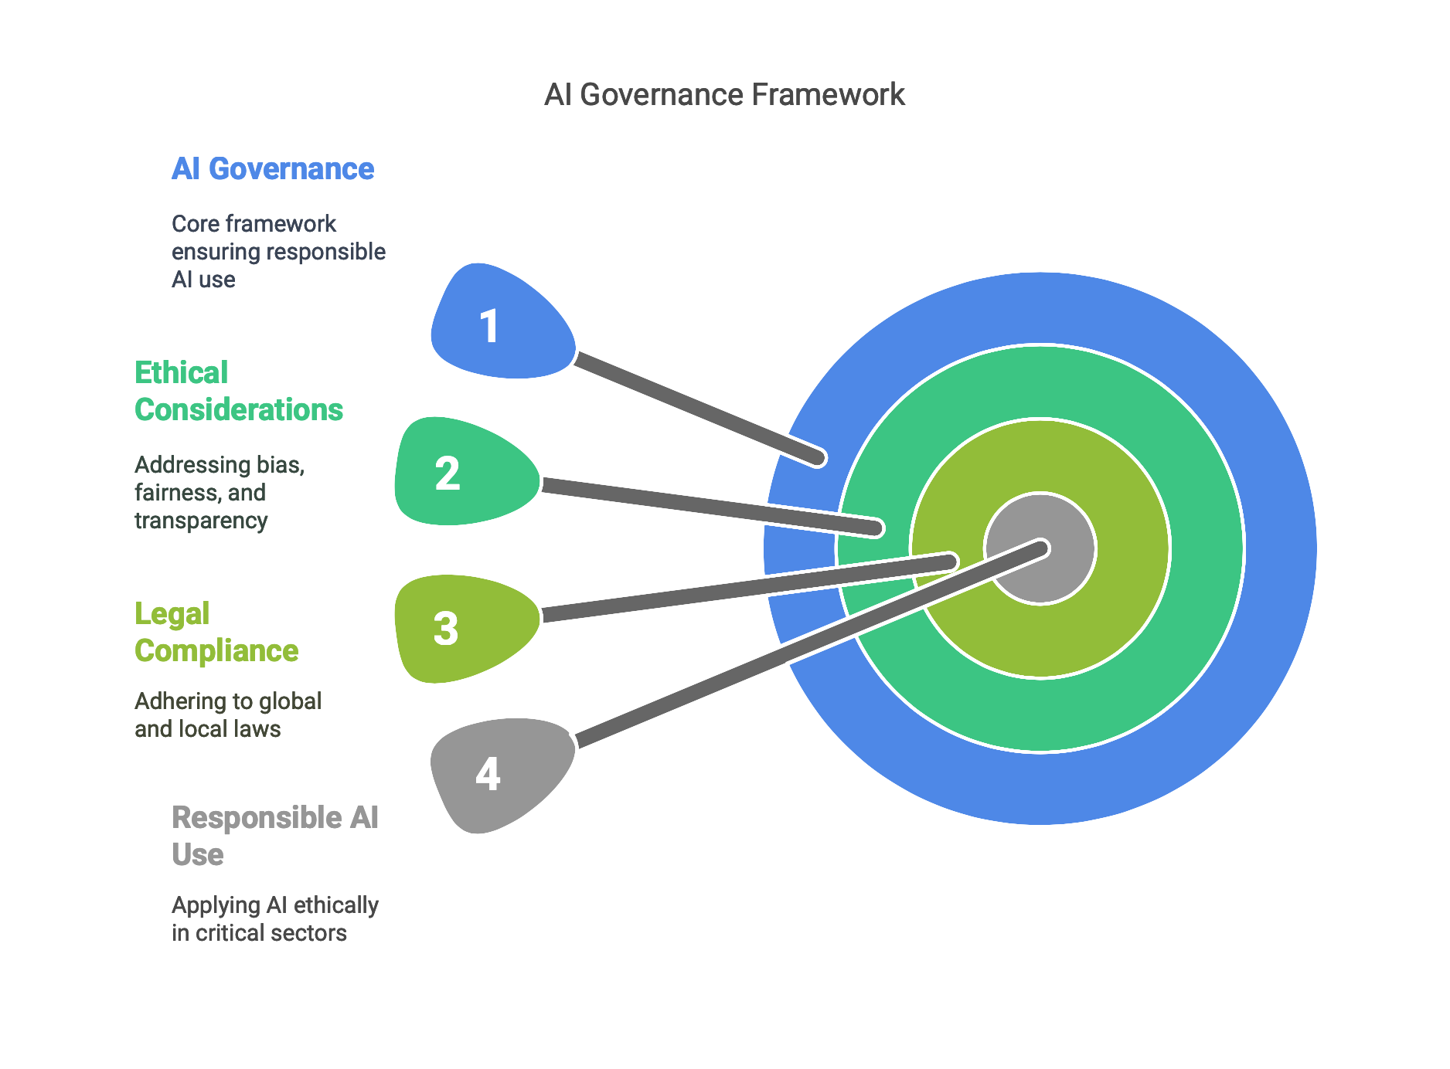
Emerging Challenges in AI Governance
What is AI Governance?
AI governance refers to the rules, policies, and ethical guidelines that ensure AI is developed and used responsibly.
It covers:
Ethical considerations (bias, fairness, transparency)
Legal and regulatory compliance (global vs. local laws)
Responsible AI use in critical sectors
Example: AI in self-driving cars must follow safety standards, ethical policies, and government regulations to ensure road safety.

Slide 10
Ethical Challenges in AI Deployment
Despite AI’s benefits, its deployment raises ethical concerns, including:
a) Bias and Fairness
AI models learn from historical data, which may contain biases.
If not addressed, AI can discriminate against certain groups.
Example: A hiring AI system prefers male candidates because it was trained on past hiring data that had gender bias.
b) Privacy and Security Risks
AI systems collect massive amounts of personal data.
If not protected, this data can be misused for identity theft or surveillance.
Example: Facial recognition AI in public spaces can track individuals without their consent, raising privacy concerns.
c) Transparency and Explainability
Many AI models, like deep learning, act as black boxes, making decisions that humans don’t understand.
Explainability is crucial, especially in healthcare and finance, where wrong decisions affect lives and livelihoods.
Example: A bank's AI denies a loan but doesn’t explain why, leaving the applicant helpless.

Slide 11
Regulatory Challenges: Global vs. Local AI Laws
AI regulation is inconsistent across countries, leading to challenges in enforcement.
Lack of Global AI Standards
Some countries, like the EU, have strict AI laws (e.g., the EU AI Act), while others have loose regulations.
This makes it hard to standardize AI safety and ethics globally.
Example:
A U.S. company deploying AI in Europe must comply with GDPR (data privacy laws), but the same AI might be used with fewer restrictions in other countries.

Slide 12
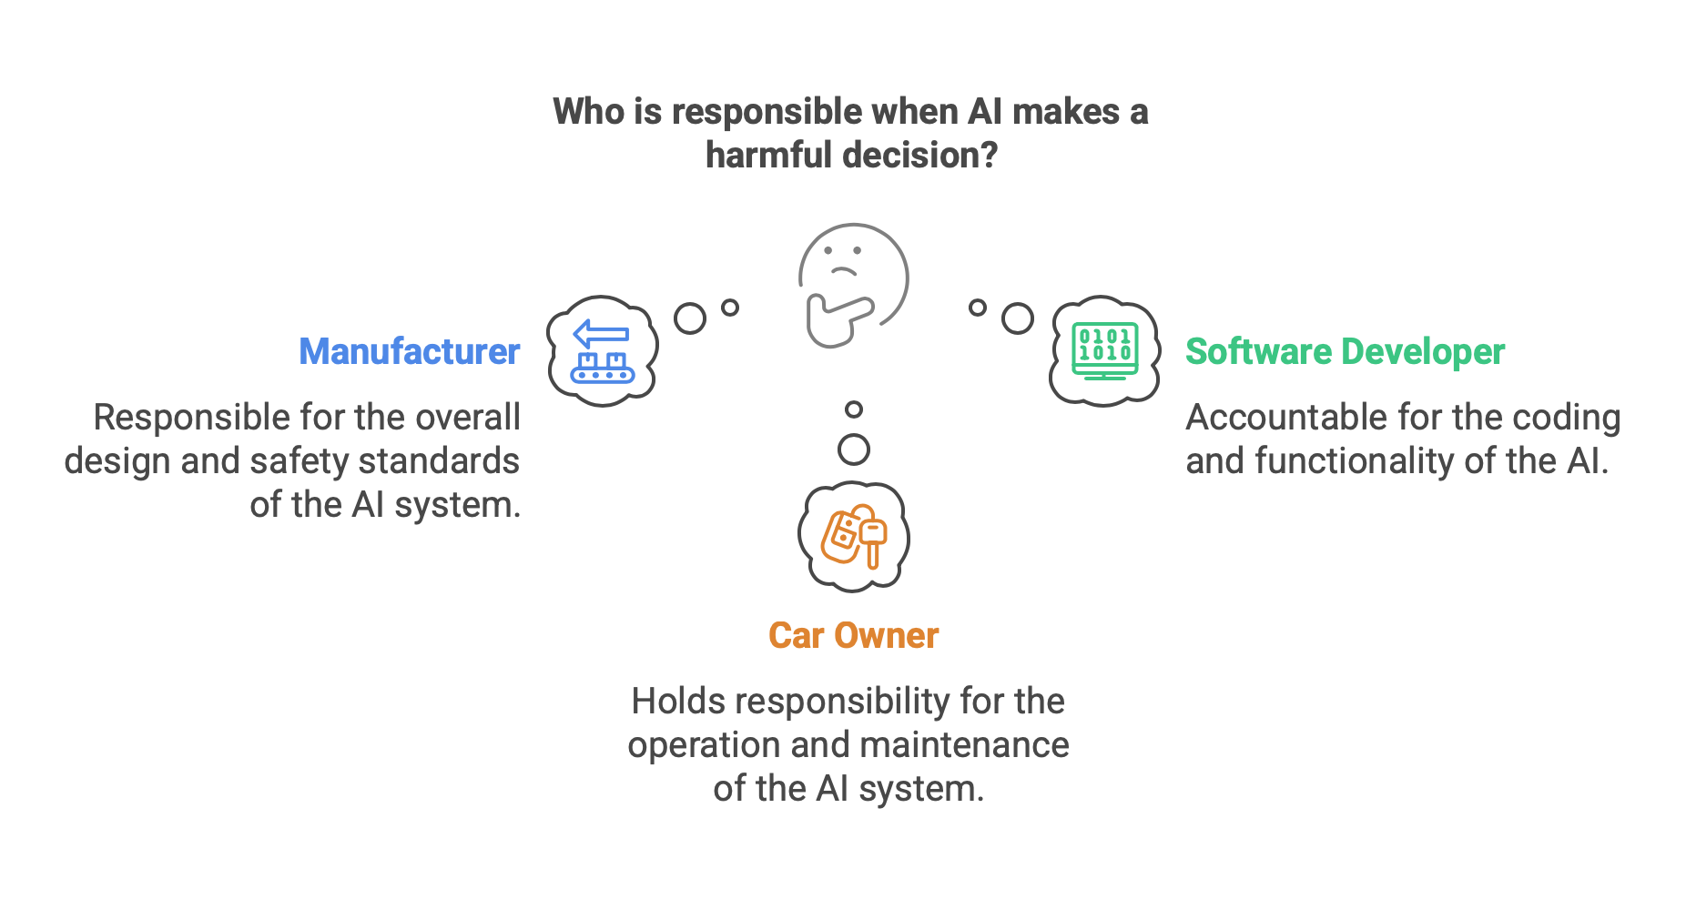
AI and Legal Liability
Who is responsible when AI makes a harmful decision?
Should the developer, company, or AI itself be legally accountable?
Example: If an autonomous car causes an accident, who is responsible—the manufacturer, software developer, or car owner?

Slide 13

Ethical AI vs. Business Profits
Companies may prioritize profitability over AI ethics, leading to unsafe or biased AI systems.
Governments struggle to balance AI innovation with consumer protection.
Example: Social media AI recommends harmful content because it increases user engagement, despite ethical concerns.

Slide 14
Regulatory Approaches by Region
Region | AI Regulation Approach
European Union (EU) | Strict laws (EU AI Act), bans harmful AI
United States (US) | Industry-led standards, minimal government oversight
China | Strong government control over AI use
India | Balancing AI innovation with ethical guidelines
Point of Discussion:
Should all countries follow the same AI regulations? Why or why not?
Who should be held legally responsible for AI mistakes?

Slide 15

AI in Critical Sectors: Risks & Challenges
a) AI in Healthcare
AI improves disease diagnosis, drug discovery, and surgery. Risks:
AI can misdiagnose diseases.
Patient data privacy concerns.
Case Study:
IBM Watson for Cancer Treatment made wrong treatment recommendations because it was trained on hypothetical cases, not real data.
Point of Discussion :
Should AI make medical decisions without doctors?
How can we ensure AI is safe in healthcare?

Slide 16
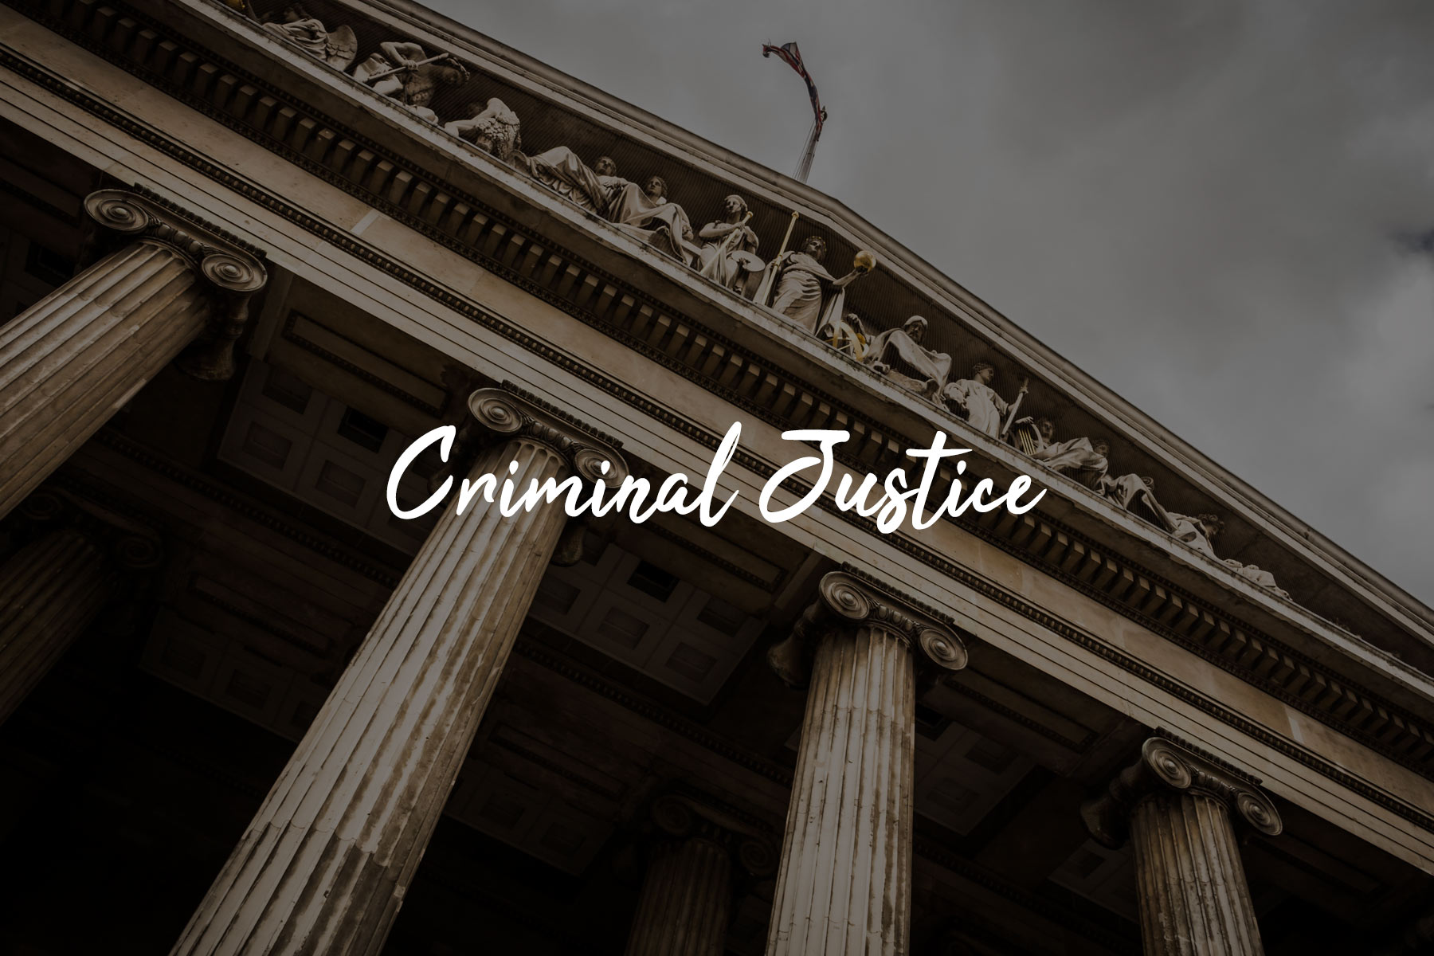
AI in Critical Sectors: Risks & Challenges
b. AI in Criminal Justice
AI helps analyze crime patterns and predict criminal behavior. Risks:
Racial bias: AI can unfairly target certain racial groups.
Lack of transparency: Courts may use AI recommendations without explaining them.
Case Study:
The COMPAS AI system in the US wrongly predicted Black defendants as more likely to commit crimes again.
Point of Discussion :
Should courts use AI to decide prison sentences?
How can AI be made fairer in justice systems?
This Photo by Unknown Author is licensed under CC BY

Slide 17

AI in Critical Sectors: Risks & Challenges
AI in Finance
AI helps detect fraud, make investment decisions, and approve loans.
Risks:
AI can unfairly deny loans based on biased data.
AI-driven stock trading could cause market crashes.
Case Study:
AI-driven stock trading caused a "flash crash" in 2010, wiping out $1 trillion in minutes.
Point of Discussion :
Should AI decide who gets a bank loan?
How can we prevent AI from damaging the economy?

Slide 18
Future of AI Governance
AI governance is crucial for ensuring ethical, fair, and safe AI deployment.
Ethical issues like bias and privacy need stronger safeguards.
Global AI regulations should aim for a balance between innovation and responsibility.
AI in healthcare, justice, and finance must be closely monitored to avoid harmful consequences.
AI is powerful but needs ethical and legal oversight.
Bias, security, and fairness are key challenges.
Governments must balance innovation and public safety.
"AI is only as fair as the data and rules we give it. To create trustworthy AI, we must ensure accountability, transparency, and fairness."

Slide 19

















الشراكات العالمية

Slide 20
شــــــكــــرًا لكــــــم
THANK YOU

